Slide 1
Randomized Algorithms CS648
Lecture 10
Expected duration of a random experiment

Slide 2
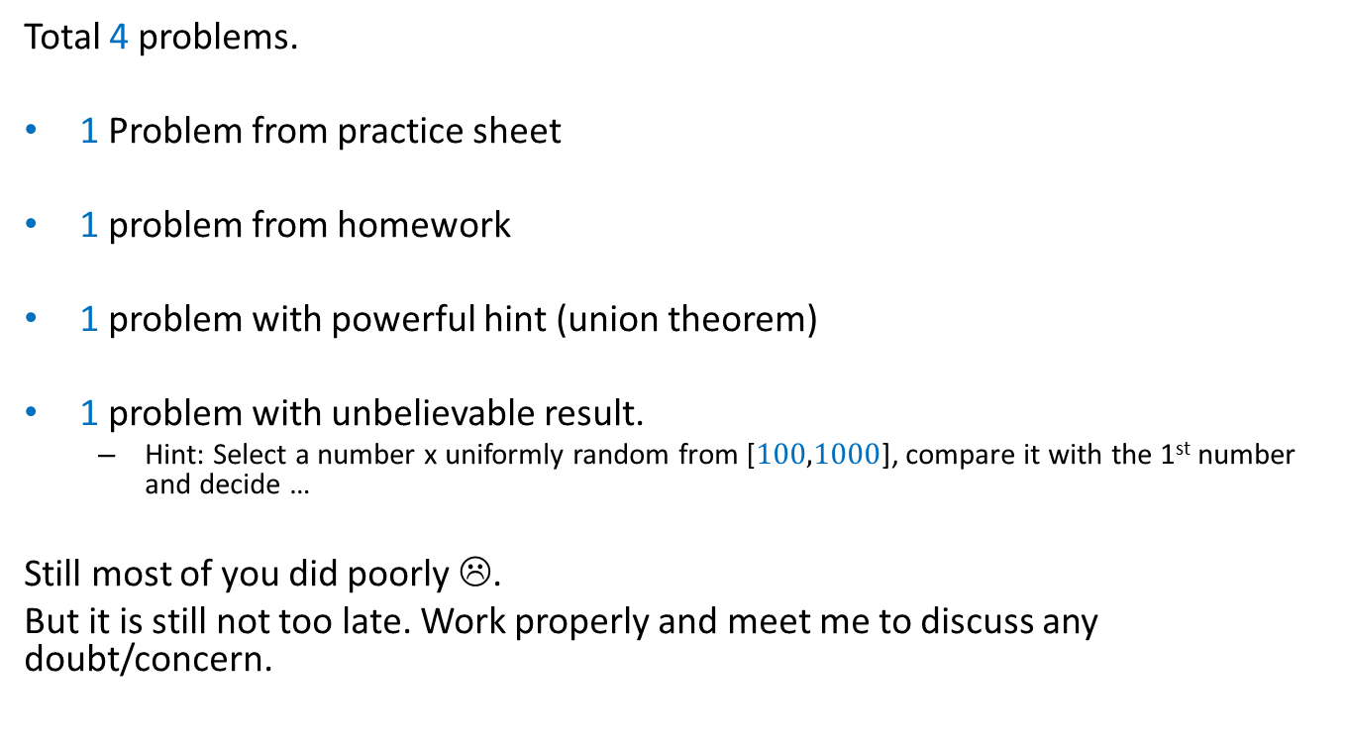
Quiz 1
Total 4 problems.
1 Problem from practice sheet
1 problem from homework
1 problem with powerful hint (union theorem)
1 problem with unbelievable result.
Hint: Select a number x uniformly random from [$100,1000$], compare it with the 1st number and decide …
Still most of you did poorly ☹.
But it is still not too late. Work properly and meet me to discuss any doubt/concern.

Slide 3

Markov’s Inequality
Theorem: Suppose $X$is a random variable defined over a probability space ($Ω$,P)
such that $X(ω)$≥ 0 for each $ω$ϵ $Ω$.
Then for any positive real number $a$,
P($X\text{≥}a$) $≤\frac{E[X]}{a}$
Important point 1:
Applicable only for a nonnegative random variable.
The proof of above theorem crucially exploits this fact.

Slide 4
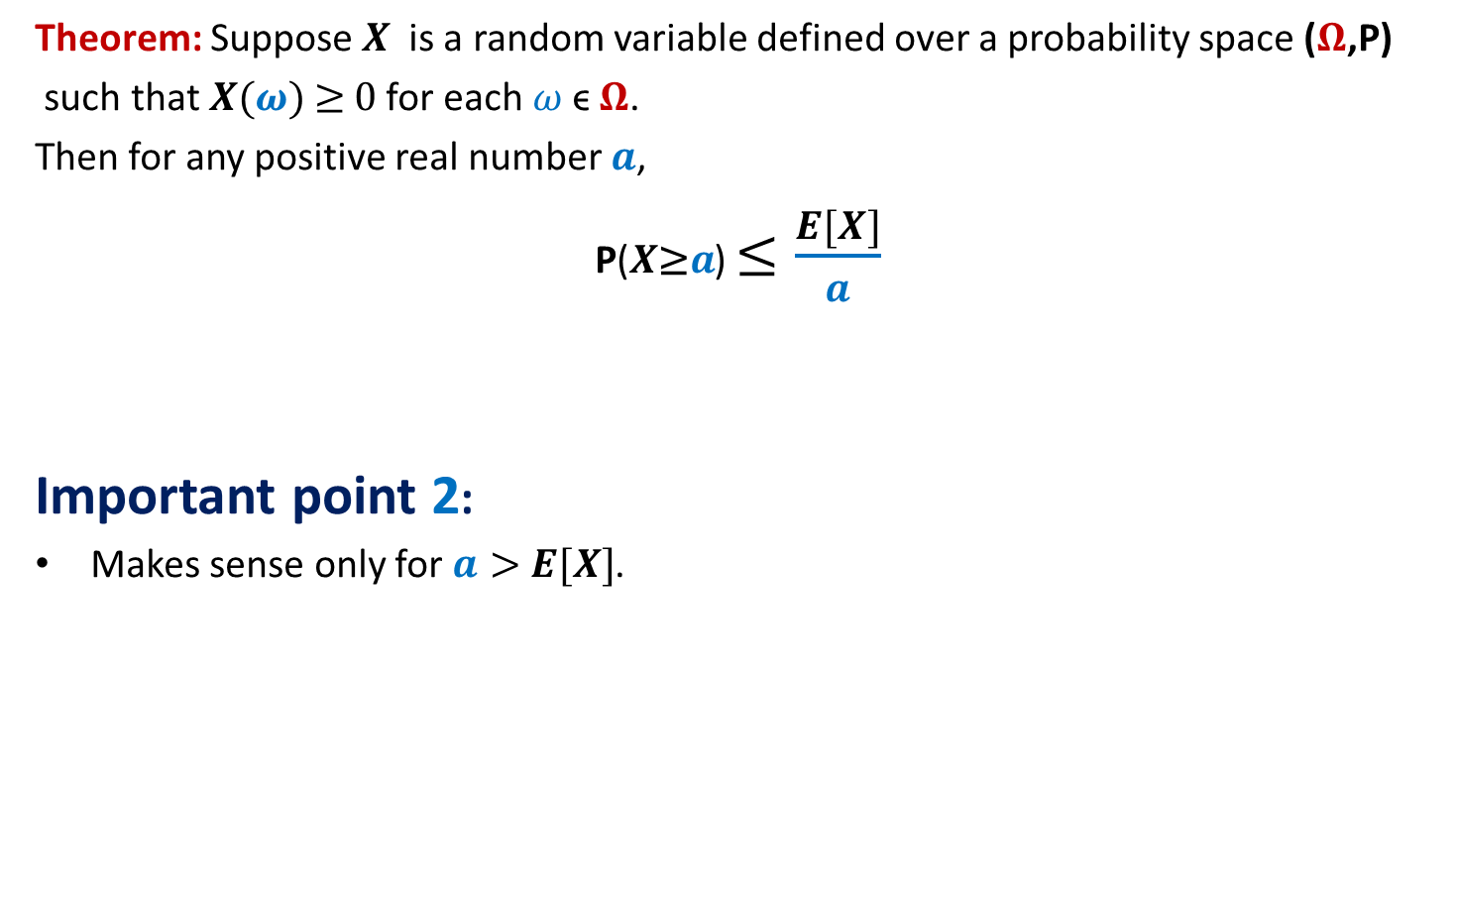
Markov’s Inequality
Theorem: Suppose $X$is a random variable defined over a probability space ($Ω$,P)
such that $X(ω)$≥ 0 for each $ω$ϵ $Ω$.
Then for any positive real number $a$,
P($X\text{≥}a$) $≤\frac{E[X]}{a}$
Important point 2:
Makes sense only for $a>$ $E[X]$.
Otherwise, probability of the above event becomes $>1$ and hence useless.

Slide 5
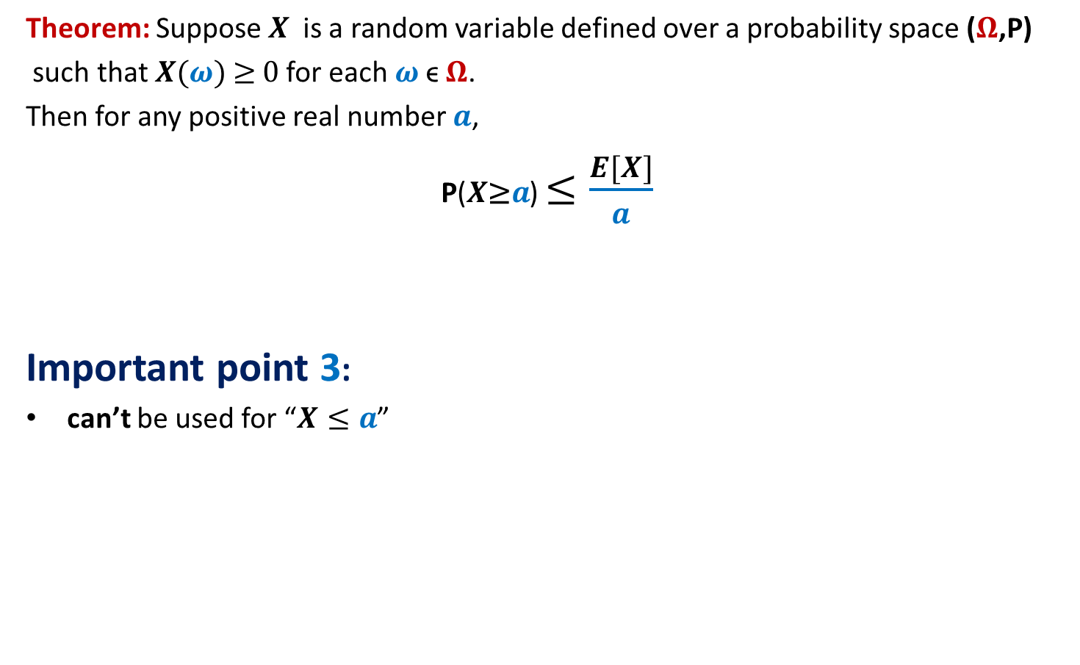
Markov’s Inequality
Theorem: Suppose $X$is a random variable defined over a probability space ($Ω$,P)
such that $X(ω)$≥ 0 for each $ω$ϵ $Ω$.
Then for any positive real number $a$,
P($X\text{≥}a$) $≤\frac{E[X]}{a}$
Important point 3:
can’t be used for “$X≤a$”
Try on your own to realize it.
Also see the proof of above theorem to get convinced.

Slide 6

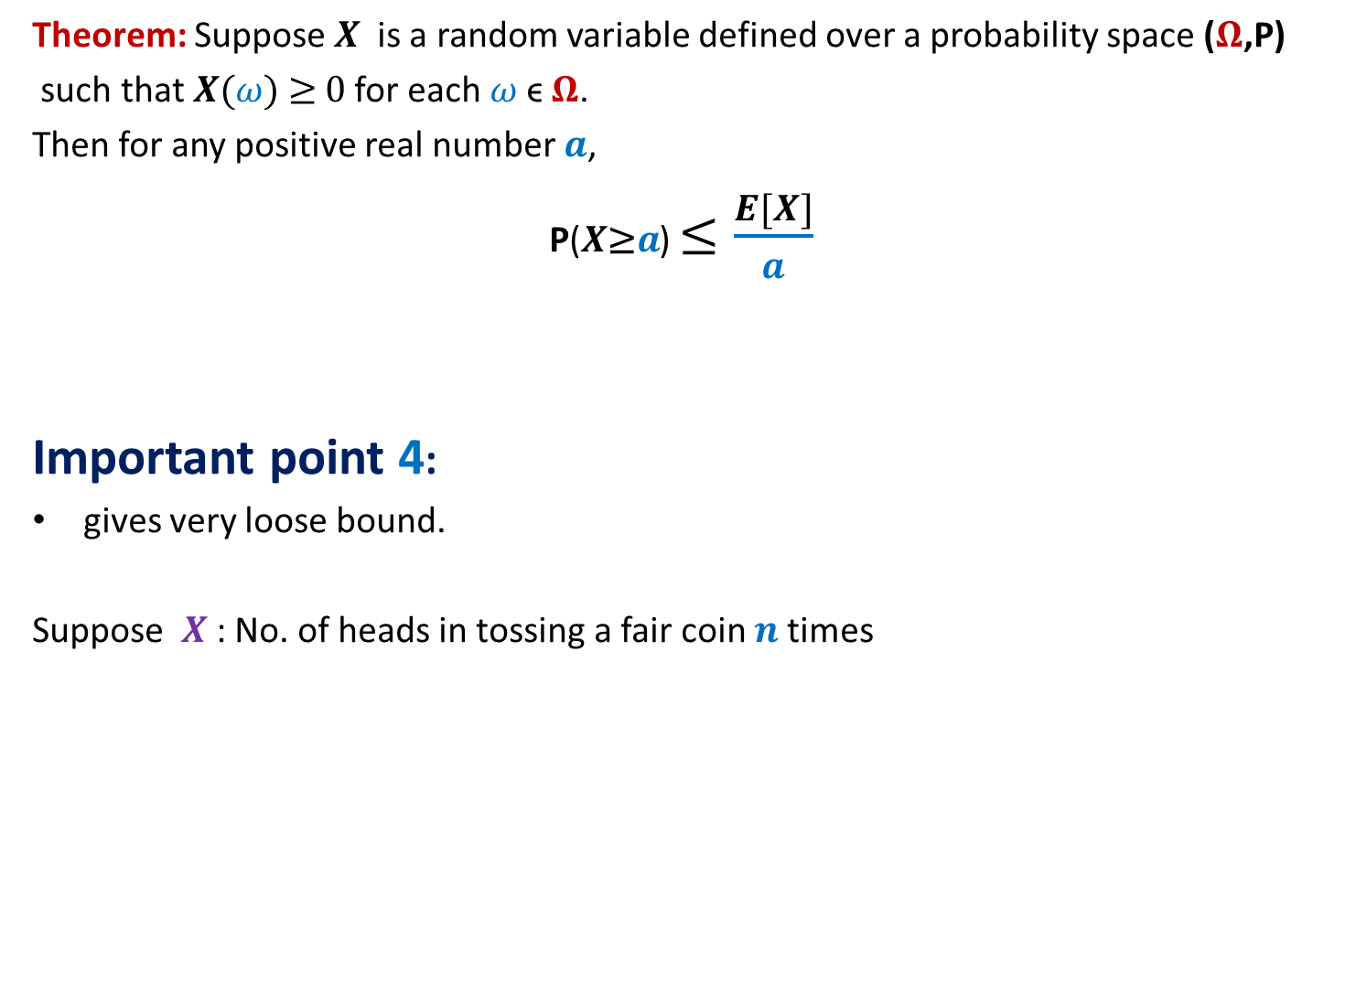
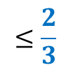
Markov’s Inequality
Theorem: Suppose $X$is a random variable defined over a probability space ($Ω$,P)
such that $X(ω)$≥ 0 for each $ω$ϵ $Ω$.
Then for any positive real number $a$,
P($X\text{≥}a$) $≤\frac{E[X]}{a}$
Important point 4:
gives very loose bound.
Suppose $X$ : No. of heads in tossing a fair coin $n$times
so not useful most of the times ☹.
P($X\text{≥} \frac{3}{4}n$)
$$≤\frac{2}{3}$$
But, it plays a key role in deriving other powerful inequalities,
like Chebyshev Inequaity and Chernoff bound ☺.

Slide 7

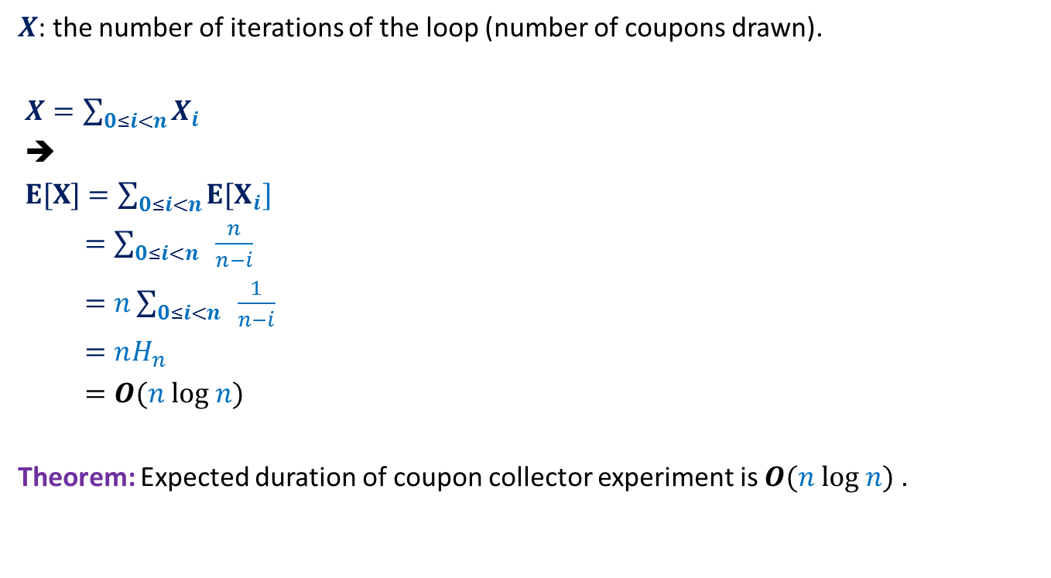





Expectation
Conditional
Given any event $ε$and
a random variable $Y$ defined over a probability space ($Ω$,P).
E[$Y$] = … + …
E[$Y$| $\overline{ε}$]
E[$Y$| $ε$]
$$ε$$
$$\overline{ε}$$
Ω
E[$Y$| $ε$] $∙$ P($ε$)
E[$Y$| $\overline{ε}$] $∙$P($\overline{ε}$)

Slide 8

Markov’s Inequality
Theorem: Suppose $X$is a random variable defined over a probability space ($Ω$,P)
such that $X(ω)$≥ 0 for each $ω$ϵ $Ω$.
Then for any positive real number $a$,
P($X\text{≥}a$) $≤\frac{E[X]}{a}$
An exercise:
Suppose E[$X \left| Y=α\right]=β$,
What bound can we get on P($X\text{≥}γ | Y=α$) ?
P($X\text{≥}γ | Y=α$) $≤ \frac{β}{γ}$

Slide 9
Some Well Known and Well STUDIED Random Variables

Slide 10
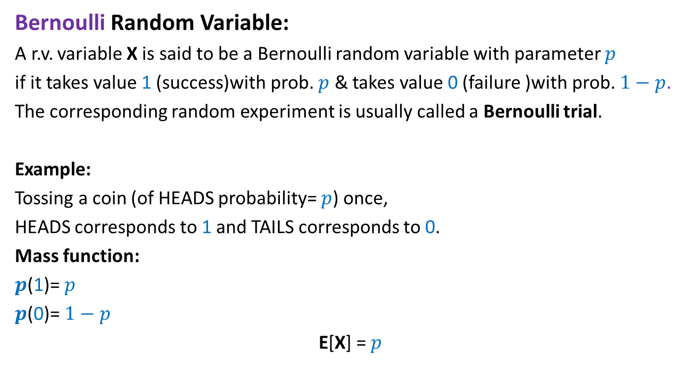
Bernoulli Random Variable
Bernoulli Random Variable:
A r.v. variable X is said to be a Bernoulli random variable with parameter $p$
if it takes value 1 (success)with prob. $p$ & takes value 0 (failure )with prob. $1−p$.
The corresponding random experiment is usually called a Bernoulli trial.
Example:
Tossing a coin (of HEADS probability= $p$) once,
HEADS corresponds to 1 and TAILS corresponds to 0.
Mass function:
$p$(1)= $p$
$p$(0)= $1−p$
E[X] = $p$

Slide 11

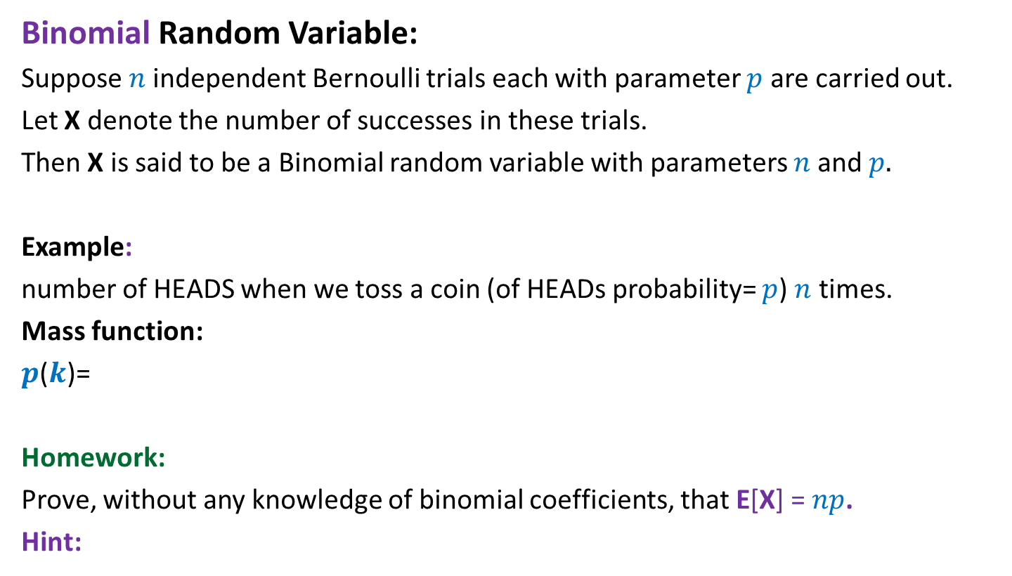

Binomial Random Variable
Binomial Random Variable:
Suppose $n$independent Bernoulli trials each with parameter $p$ are carried out.
Let X denote the number of successes in these trials.
Then X is said to be a Binomial random variable with parameters $n$and $p.$
Example:
number of HEADS when we toss a coin (of HEADs probability= $p$) $n$ times.
Mass function:
$p$($k$)=
Homework:
Prove, without any knowledge of binomial coefficients, that E[X] = $np$.
Hint:
$$\left({n \atop k}\right)p^{k}{\left(1−p\right)}^{k}$$
X = $X_{1}+…{+X}_{n}$
,where $X_{i}$ is a Bernoulli random variable for the $i$th Bernoulli trial.

Slide 12

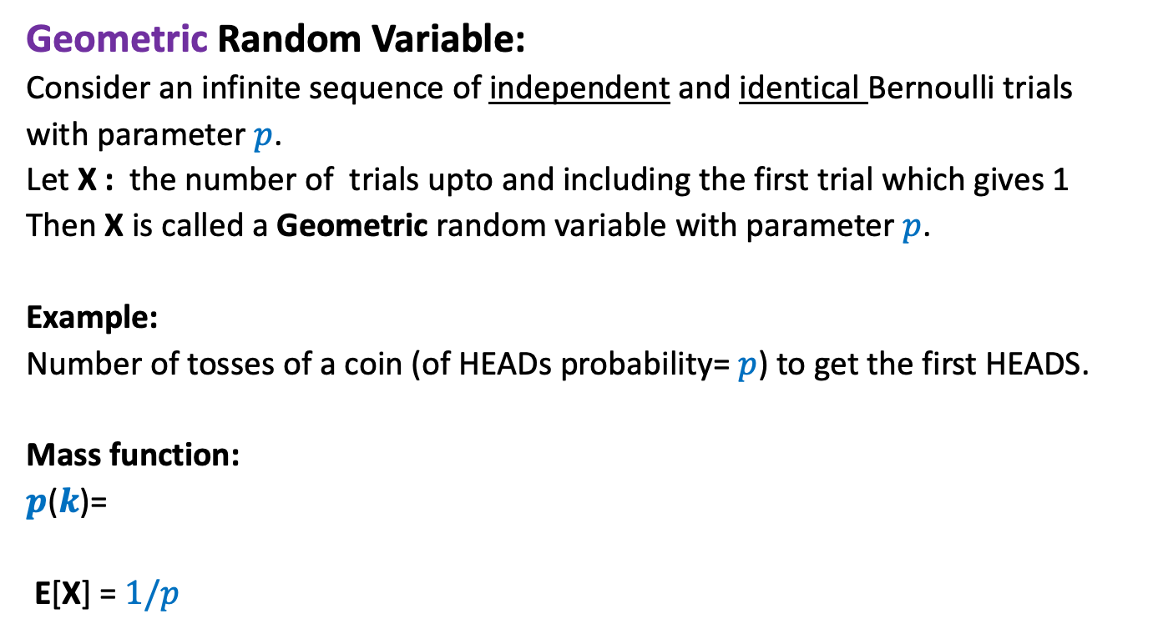
Geometric Random Variable
Geometric Random Variable:
Consider an infinite sequence of independent and identical Bernoulli trials
with parameter $p$.
Let X : the number of trials upto and including the first trial which gives 1
Then X is called a Geometric random variable with parameter $p$.
Example:
Number of tosses of a coin (of HEADs probability= $p$) to get the first HEADS.
Mass function:
$p$($k$)=
E[X] = $1/p$
$${\left(1−p\right)}^{k−1}p$$

Slide 13
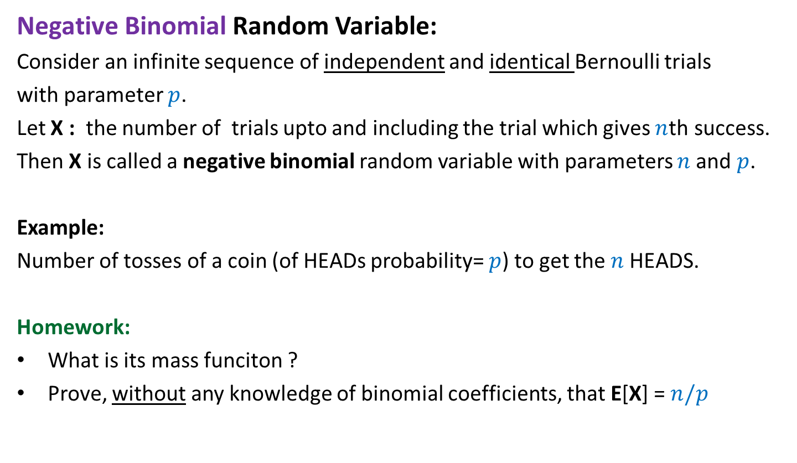
Negative Binomial Random Variable
Negative Binomial Random Variable:
Consider an infinite sequence of independent and identical Bernoulli trials
with parameter $p$.
Let X : the number of trials upto and including the trial which gives $n$th success.
Then X is called a negative binomial random variable with parameters $n$and $p$.
Example:
Number of tosses of a coin (of HEADs probability= $p$) to get the $n$HEADS.
Homework:
What is its mass funciton ?
Prove, without any knowledge of binomial coefficients, that E[X] = $n/p$

Slide 14
coupon Collector Problem

Slide 15
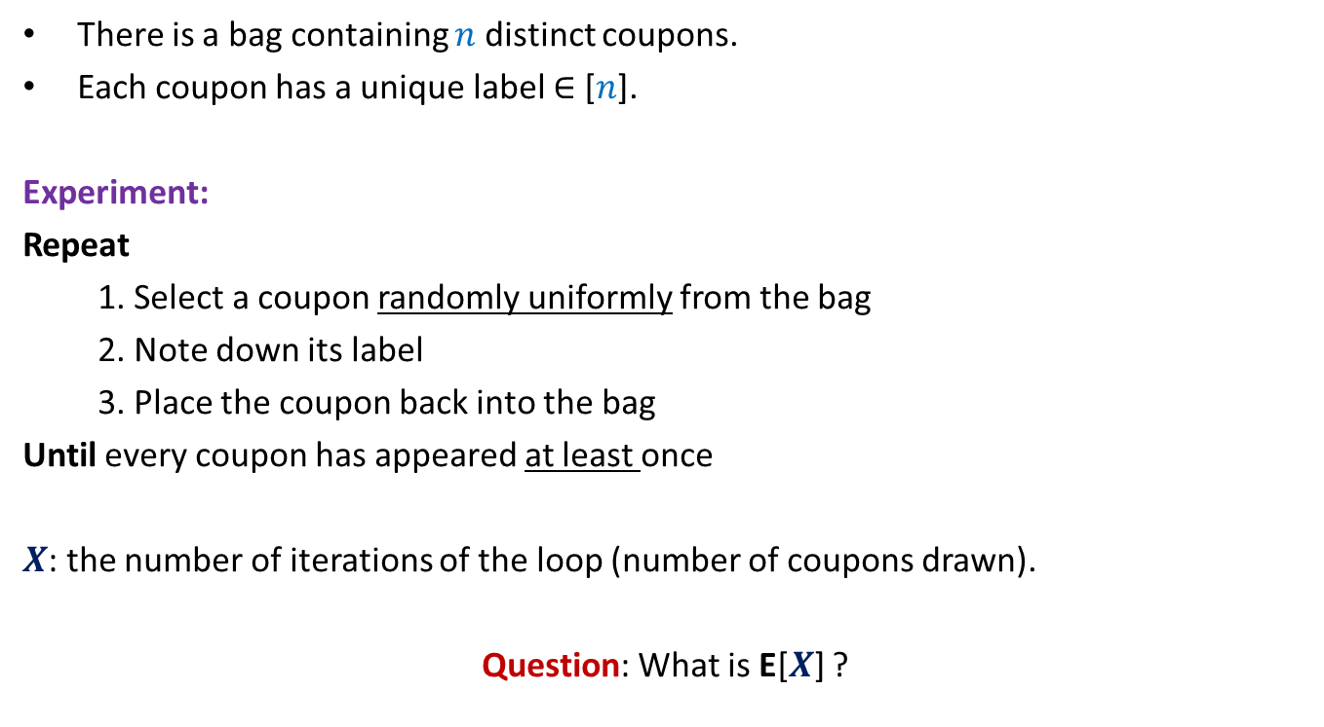
Coupon Collector Problem
There is a bag containing $n$ distinct coupons.
Each coupon has a unique label $∈$ [$n$].
Experiment:
Repeat
1. Select a coupon randomly uniformly from the bag
2. Note down its label
3. Place the coupon back into the bag
Until every coupon has appeared at least once
$X$: the number of iterations of the loop (number of coupons drawn).
Question: What is E[$X$] ?

Slide 16

Example
$n$=5
1
4
5
3
2
3
1
3
3
1
2
2
1
5
1
3
5
3
4
Done in 14 samplings
5
5
1
2
1
2
5
4
4
1
2
3
Done in 12 samplings
3
2
2
3
3
3
1
1
5
1
3
5
3
2
2
5

Slide 17

Coupon Collector Problem
$X$: the number of iterations of the loop (number of coupons drawn).
Question: What is E[$X$] ?
Standard method:
E[$X$] = $\sum_{k≥n}{k ∙P(X=k)}$
?
No easy way !!

Slide 18
Coupon Collector Problem
no
coupon
seen
all
coupons
seen
This transition is not sudden.
In fact it is a gradual transition through various discrete stages.
Can you see these discrete stages ?

Slide 19
Reviewing Example
$n$=5
1
4
5
3
2
0
5
3
1
3
3
1
2
2
1
5
1
3
5
3
4

Slide 20
Reviewing Example
$n$=5
1
4
5
3
2
0
1
2
3
4
5
3
3
1
1
3
3
1
2
2
2
1
5
5
1
3
5
3
4
4
0
1
2
3
4
5
5
5
1
2
1
2
5
4
4
1
2
3

Slide 21
Reviewing Example
Each instance of coupon collector problem has to pass through these stages.
Can you think of the most generic picture of this experiment ?
$n$=5
1
4
5
3
2
0
1
2
3
4
5
3
1
3
3
1
2
2
1
5
1
3
5
3
4
0
1
2
3
4
5
5
5
1
2
1
2
5
4
4
1
2
3
0
1
2
3
4
3
2
2
3
3
3
1
1
5
1
3
5
3
2
2
5

Slide 22





Coupon Collector Problem
$X_{i}=$ No. of coupons sampled from the moment
to the moment ??
no
coupon
seen
all
coupons
seen
1
2
3
4
$i$ th distinct coupon was selected
$i+1$ th distinct coupon was selected
Does $E[X_{i}]$ depend upon which distinct $i$coupons were selected in the past ?
Does $E[X_{i}]$ depend upon the number of samplings done in the past ?
No
No

Slide 23


Coupon Collector Problem
$X$: the number of iterations of the loop (number of coupons drawn).
Question: What is E[$X$] ?
$X_{i}=$ No. of coupons sampled from the moment ??
to the moment ??
Can you seem some relation between $X$and $X_{i}$’s ?
$i$ th distinct coupon was selected
$i+1$ th distinct coupon was selected

Slide 24





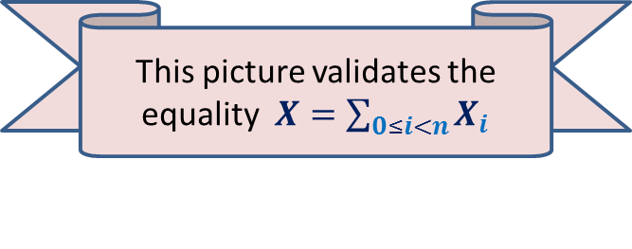
Reviewing Example
$n$=5
1
4
5
3
2
$X_{0}$=1
$X_{1}$=1
$X_{2}$=4
$X_{3}$=3
$X_{4}$=5
0
1
2
3
5
4
3
1
3
3
1
2
2
1
5
1
3
5
3
4
This picture validates the equality $X=\sum_{0≤i<n}{X_{i}}$

Slide 25

Coupon Collector Problem
$X$: the number of iterations of the loop (number of coupons drawn).
$$X=\sum_{0≤i<n}{X_{i}}$$
➔
$$E[X]=\sum_{0≤i<n}{{E[X}_{i}]}$$
Question: What is ${E[X}_{i}$] ?

Slide 26
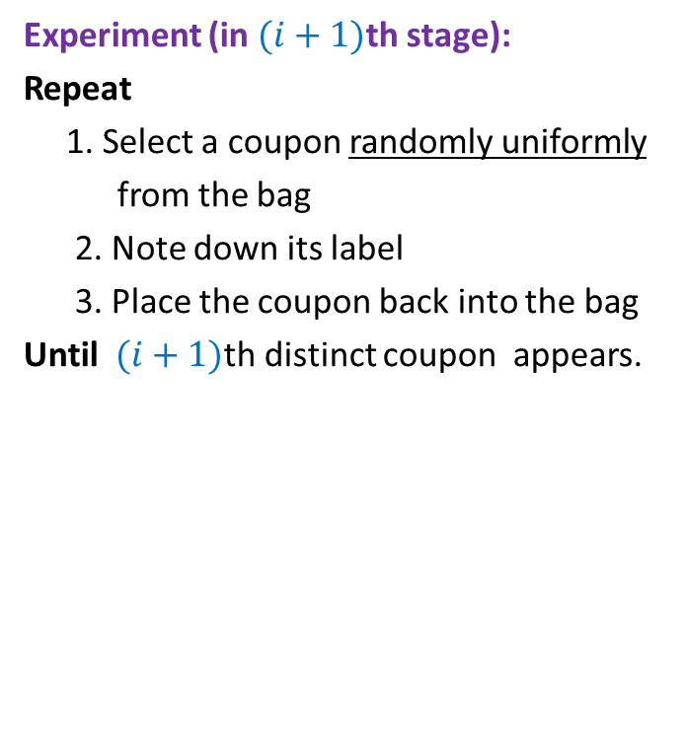


Calculating E[$X_{i}$]
Experiment (in $(i+1)$th stage):
Repeat
1. Select a coupon randomly uniformly
from the bag
2. Note down its label
3. Place the coupon back into the bag
Until $(i+1)$th distinct coupon appears.
$$n$$

Slide 27
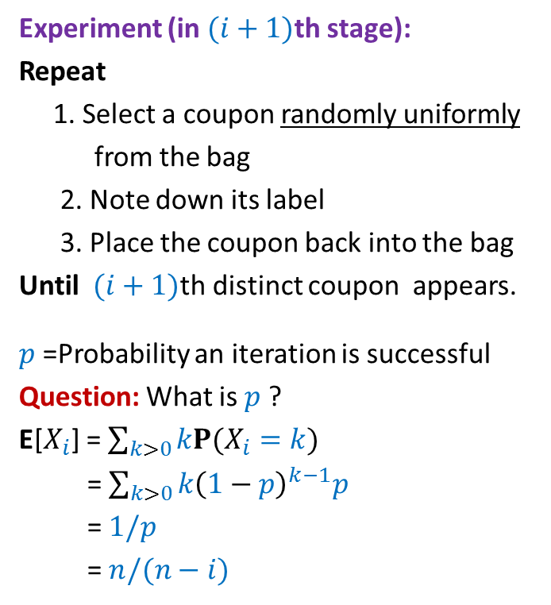


Calculating E[$X_{i}$]
Experiment (in $(i+1)$th stage):
Repeat
1. Select a coupon randomly uniformly
from the bag
2. Note down its label
3. Place the coupon back into the bag
Until $(i+1)$th distinct coupon appears.
$p$ =Probability an iteration is successful
Question: What is $p$ ?
E[$X_{i}$] = $\sum_{k>0}{kP(X_{i}=k)}$
= $\sum_{k>0}{k{\left(1−p\right)}^{k−1}p}$
= $1/p$
= $n/(n−i)$
$$n$$
$$(n−i)/n$$
$$i$$

Slide 28
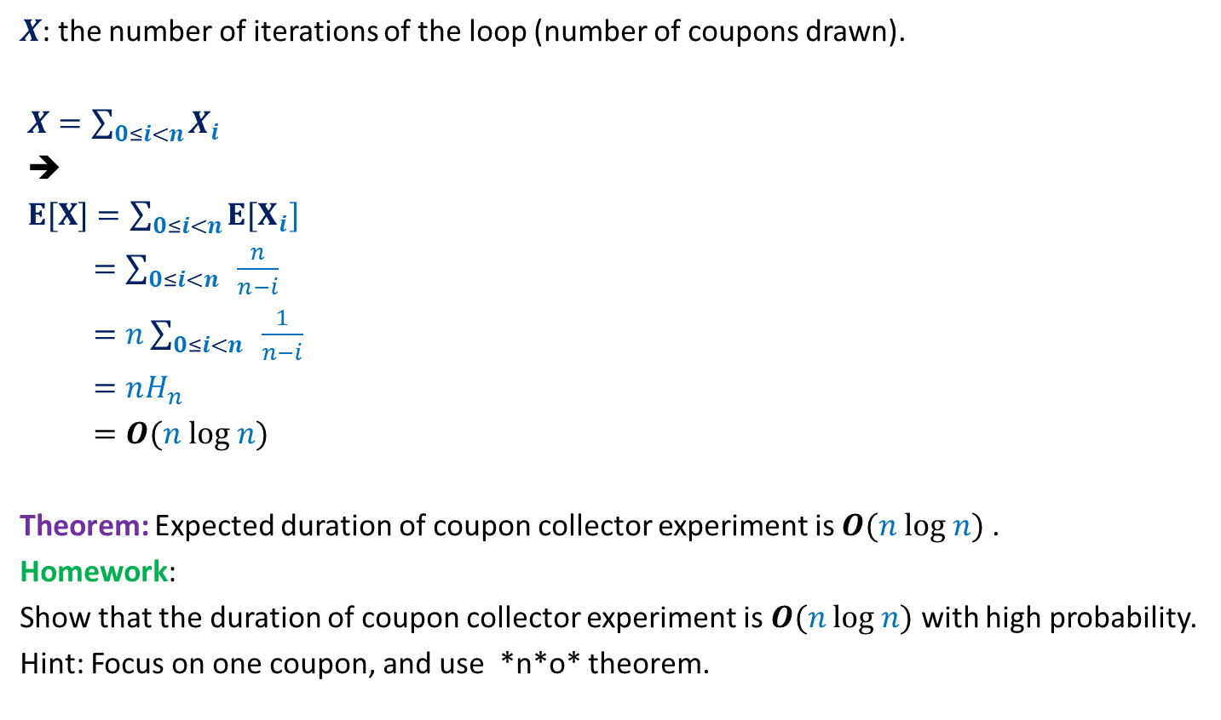
Coupon Collector Problem
$X$: the number of iterations of the loop (number of coupons drawn).
$X=\sum_{0≤i<n}{X_{i}}$
➔
$E[X]=\sum_{0≤i<n}{{E[X}_{i}]}$
$=\sum_{0≤i<n}{ \frac{n}{n−i}}$
$=n\sum_{0≤i<n}{ \frac{1}{n−i}}$
$=nH_{n}$
$=O(n log n)$
Theorem: Expected duration of coupon collector experiment is $O(n log n)$ .
Homework:
Show that the duration of coupon collector experiment is $O(n log n)$ with high probability.
Hint: Focus on one coupon, and use *n*o* theorem.

Slide 29
Discrete Random Walk on a LINE

Slide 30
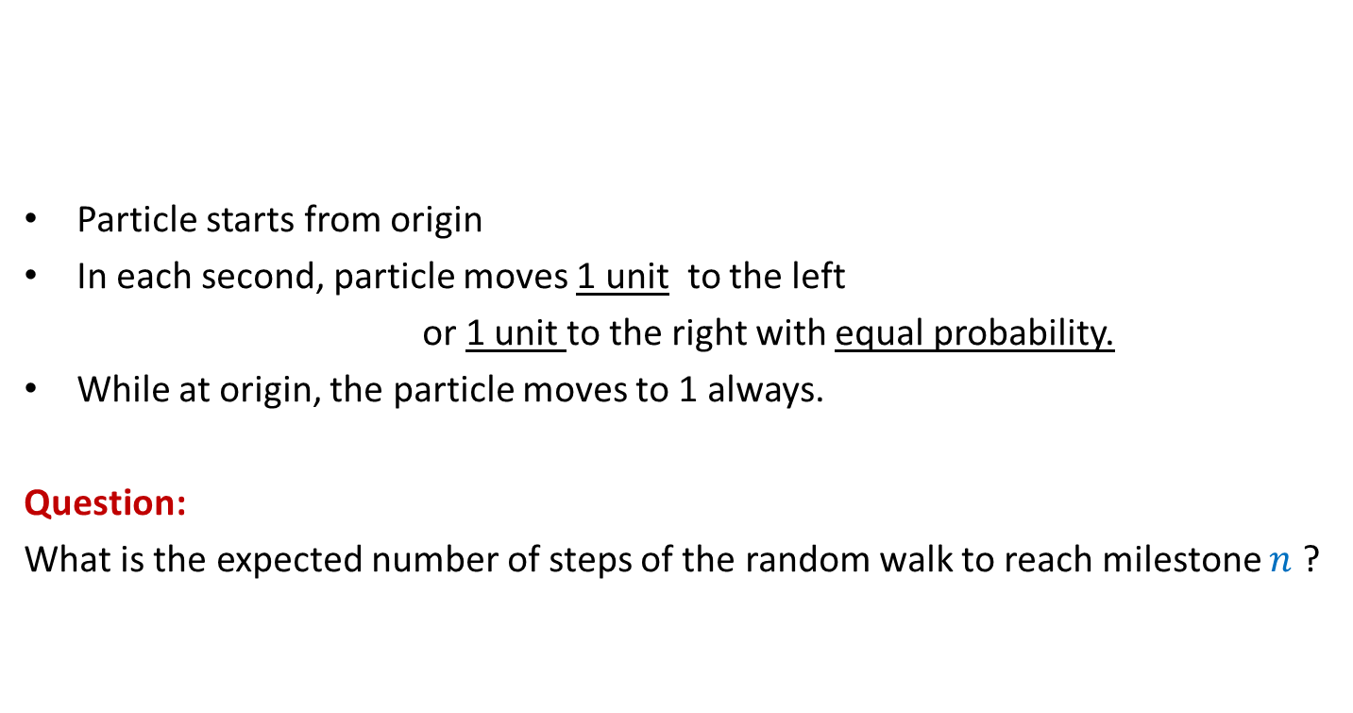
Discrete Random Walk
Particle starts from origin
In each second, particle moves 1 unit to the left
or 1 unit to the right with equal probability.
While at origin, the particle moves to 1 always.
Question:
What is the expected number of steps of the random walk to reach milestone $n$ ?
0 1 2 3 4 5 6 7 8 … n n+1

Slide 31
An example
0 1 2 3 4 5 6 7 8 …
I, and perhaps you too,
could not notice the walk. So let us trace the walk slowly.

Slide 32
A careful look at the example
0 1 2 3 4 5 6 7 8 …
Can you break the walk 0→8 into stages ? Think carefully …

Slide 33
A careful look at the example
0 1 2 3 4 5 6 7 8 …
Walk starting from 0 and terminating at 5

Slide 34
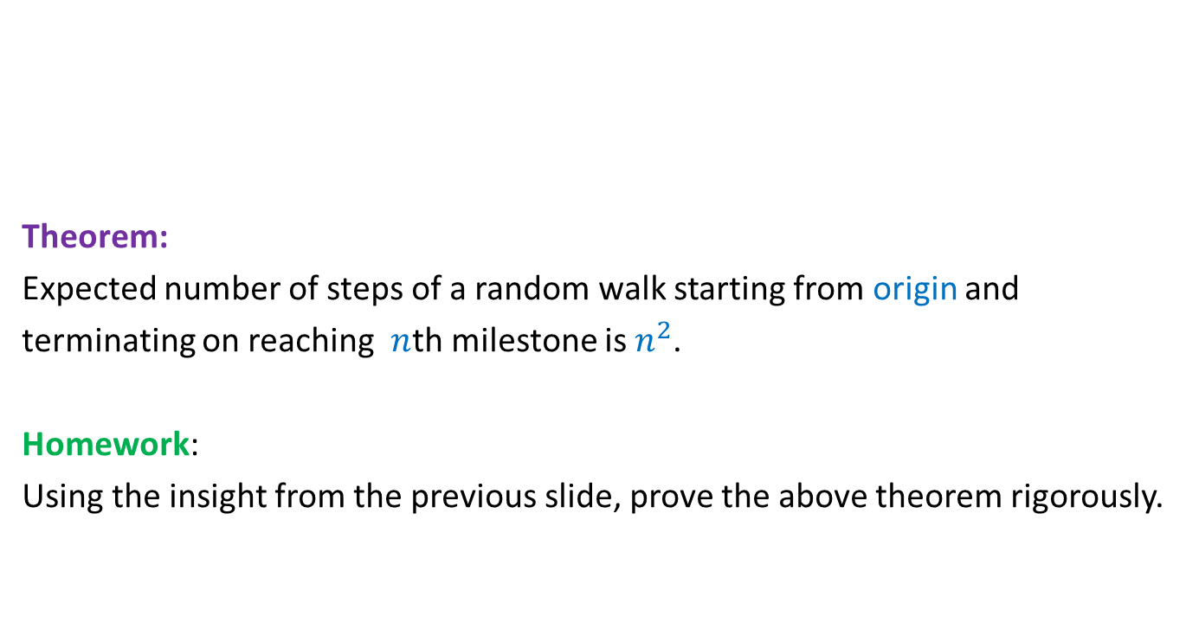
Theorem:
Expected number of steps of a random walk starting from origin and
terminating on reaching $n$th milestone is $n^{2}$.
Homework:
Using the insight from the previous slide, prove the above theorem rigorously.

Slide 35
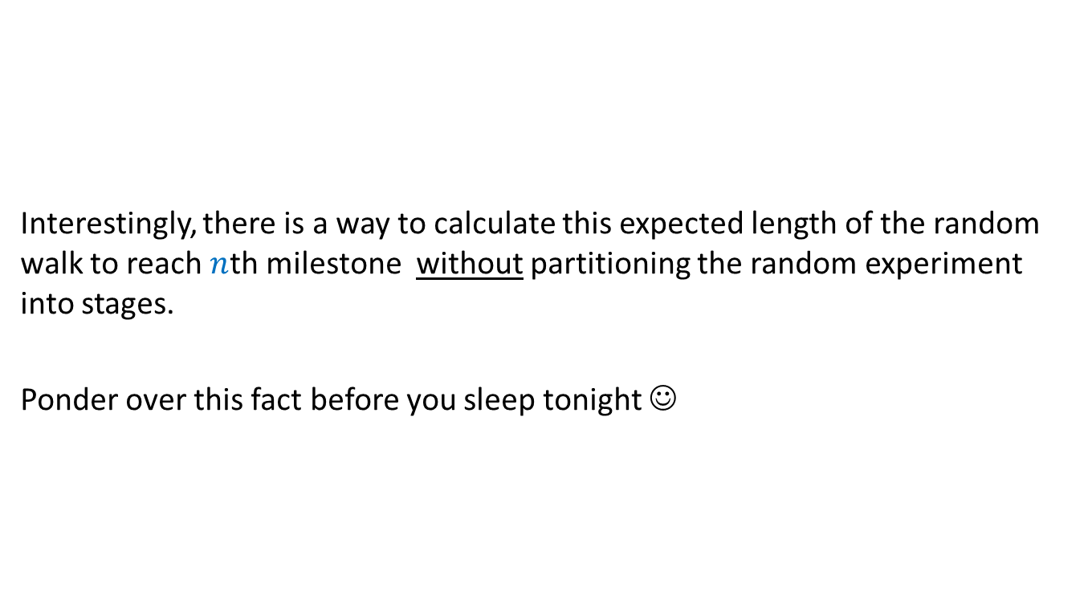
For fun only
Interestingly, there is a way to calculate this expected length of the random walk to reach $n$th milestone without partitioning the random experiment into stages.
Ponder over this fact before you sleep tonight ☺

Slide 36
Expected duration of a random experiment
Let X denote the r.v. for the duration of a randomized experiment.
To calculate E[X], the following approach is sometimes useful:
Partition the experiment into stages carefully.
Calculate expected duration of each stage.
Using linearity of expectation, calculate E[X].

Slide 37
Distributed Client-serveR Problem

Slide 38
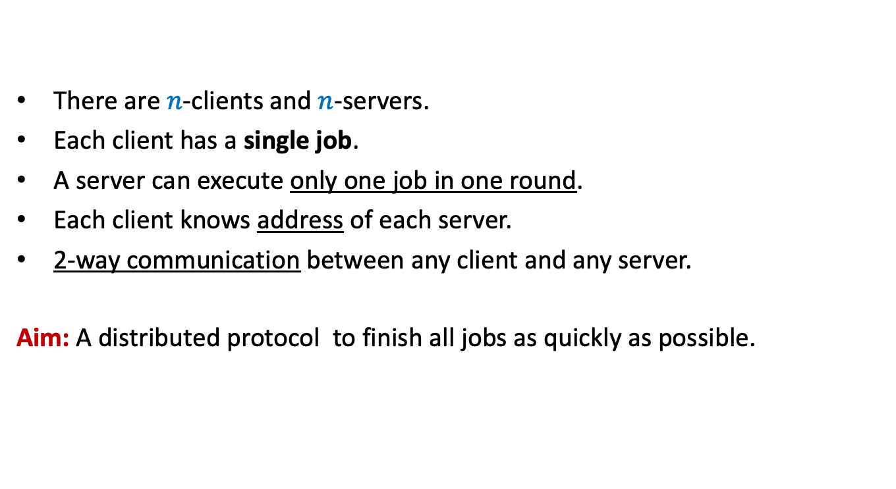
Distributed Client-Server Problem
There are $n$-clients and $n$-servers.
Each client has a single job.
A server can execute only one job in one round.
Each client knows address of each server.
2-way communication between any client and any server.
Aim: A distributed protocol to finish all jobs as quickly as possible.

Slide 39
Distributed Client-Server Problem
Randomized protocol (one round)
Each client sends a request to a server selected r.u.i.
Each server which receives one or more requests,
accepts only one request and finishes the corresponding job.
Each client, whose job is finished, leaves the system.
The remaining clients repeat the same procedure in next round.
Question: what is the expected number of rounds to finish all jobs?

Slide 40
Distributed Client-Server problem
1
2
3
4
5
6
7
8
Clients
It can be framed as our familiar
ball-bin problem.
☺
Servers
1 2 3 4 5 6 7 8

Slide 41
Distributed Client-Server problem
1
2
3
4
5
6
7
8
Balls
Bins
1 2 3 4 5 6 7 8

Slide 42
Distributed Client-Server problem Randomized protocol
Round 1
1
2
3
4
5
6
7
8
1 2 3 4 5 6 7 8

Slide 43
Distributed Client-Server problem Randomized protocol
3
4
7
8
1 2 3 4 5 6 7 8

Slide 44
Distributed Client-Server problem Randomized protocol
Round 2
3
4
7
8
1 2 3 4 5 6 7 8

Slide 45
Distributed Client-Server problem Randomized protocol
Round 3
8
1 2 3 4 5 6 7 8

Slide 46
Distributed Client-Server problem Randomized protocol
Round 1
1
2
3
$$n−1$$
$$n$$
$Y$ : no. of balls leaving the system in round $1$.
E[$Y$] = ??
= $n−n{\left(1−\frac{1}{n}\right)}^{n}$
= $\left(1−\frac{1}{e}\right)n$
$X_{1}$: no. of balls remaining in the system after round $1$.
E[$X_{1}$] = $\frac{n}{e}$
1 2 3 … $n$-1 $n$
$$n −expected no. of empty bins$$
$$≥$$
$$≤$$

Slide 47
Distributed Client-Server problem Randomized protocol
Round $i+1$
1
2
$$m$$
E[$X_{1}$] = $\frac{n}{e}$
$X_{i}$: no. of balls at the end of round $i$.
E[$X_{i+1}$| $X_{i}=m$] = ??
$$m$$
1 2 … $n$-1 $n$
$$≤\frac{m}{e}$$

Slide 48
Distributed Client-Server problem Randomized protocol
Lemma1 : After round $i+1$, the expected number of balls left
is less than $\frac{1}{e}$th fraction of the balls after round $i$.
$r_{i}=\frac{X_{i}}{n}$: fraction of balls in the system after round $i$.
Lemma 1 implies E[$r_{i+1}$]$≤ ??$
➔ If everything goes as expected, then
$${\frac{1}{e}E[r}_{i}]$$
Round | No. of balls in the system | Fraction of balls in the system
0 | $$n$$ | 1
1
$$n/e$$
$$1/e$$
2
$$<n/e^{2}$$
$$<1/e^{2}$$
This table gives the intuition for the expected no. of rounds but it directly does not help us to calculate the expected no. of rounds ? It also does not directly help to get a high prob. Bound. Convince yourself before proceeding further.

Slide 49

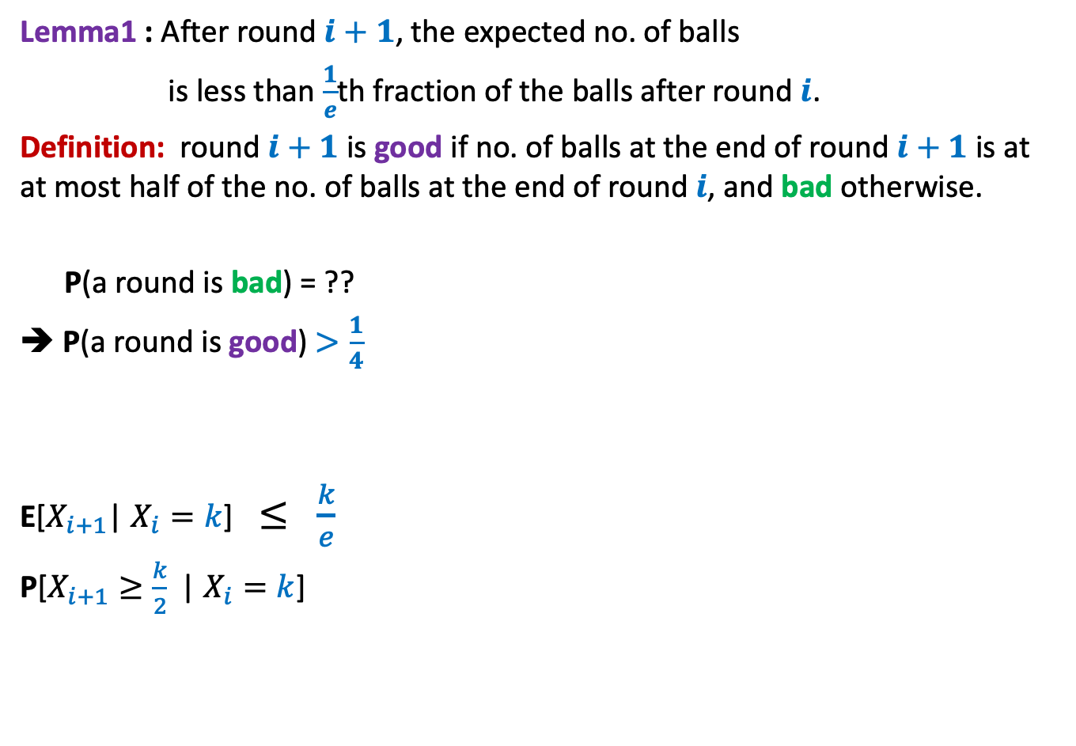


Distributed Client-Server problem Randomized protocol
Lemma1 : After round $i+1$, the expected no. of balls
is less than $\frac{1}{e}$th fraction of the balls after round $i$.
Definition: round $i+1$is good if no. of balls at the end of round $i+1$ is at at most half of the no. of balls at the end of round $i$, and bad otherwise.
P(a round is bad) = ??
➔ P(a round is good) $>\frac{1}{4}$
E[$X_{i+1}$| $X_{i}=k$]$≤ \frac{k}{e}$
P[$X_{i+1}≥\frac{k}{2} \text{| }X_{i}=k$]
$$≤\frac{2}{e}$$
$$≤\frac{3}{4}$$
Use Markov’s Inequality
$$≤\frac{2}{e}$$

Slide 50

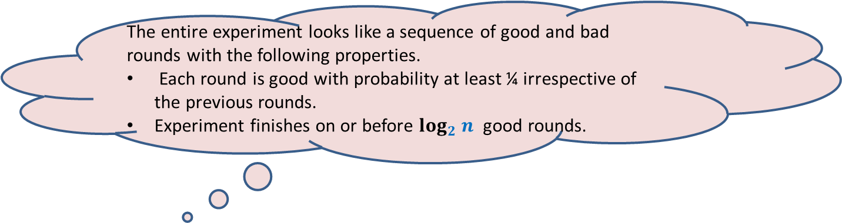
Distributed Client-Server problem Randomized protocol
Lemma1 : After round $i+1$, the expected no. of balls
is less than $\frac{1}{e}$th fraction of the balls after round $i$.
Question: After how many good rounds will there be no ball left ?
Expected no. of rounds = ??
The entire experiment looks like a sequence of good and bad rounds with the following properties.
Each round is good with probability at least ¼ irrespective of the previous rounds.
Experiment finishes on or before $log_{2} n$ good rounds.
$$log_{2} n$$
Each round is good iwith probability at least $\frac{1}{4}$
$$≤4 \log_{2}n$$

Slide 51
Distributed Client-Server problem Randomized protocol
Theorem:
The Randomized protocol will terminate in expected O($\log_{2}n$) rounds.
This bound is very loose.
Can you see why ?

Slide 52
An important insight that we missed
Question: What is the cause of multiple rounds for a ball ?
Answer: presence of other competing balls
INSIGHT
As the algorithm proceeds:
The number of these competing balls reduce
but the number of bins remain unchanged
➔
Chances of a ball to leave the system increases as the algorithm proceeds.

Slide 53
Distributed Client-Server problem
NEW insight
1
2
3
4
5
6
7
8
Balls
Bins
1 2 3 4 5 6 7 8

Slide 54
Calculating expected no. of rounds
with NEW insight

Slide 55
First some discrete mathematics

Slide 56
Recurrence 1
$r_{0}=1$
For any $i>0$, $r_{i}=\frac{1}{2}r_{i−1}$
Question: What is the smallest value of $i$ such that $r_{i}≤\frac{1}{n}$ for a given $n>1$?
Answer: ??
$r_{0}=1$
For any $i>0$, $r_{i}=c r_{i−1}$ for some $0<c<1$
Question: What is the smallest value of $i$ such that $r_{i}≤\frac{1}{n}$ for a given $n>1$?
Answer: ??
$$⌈\log_{2}{n}⌉$$
$$⌈\log_{\frac{1}{c}}{n}⌉$$

Slide 57
Recurrence 2
$r_{0}=\frac{1}{2}$
For any $i>0$, $r_{i}= {\left(r_{i−1}\right)}^{2}$
Question: What is the smallest value of $i$ such that $r_{i}≤\frac{1}{n}$ for a given $n>1$?
Answer: ??
$r_{0}=a$ for some $0<a<1$
For any $i>0$, $r_{i}={\left(r_{i−1}\right)}^{c}$ for some $1<c$
Question: What is the smallest value of $i$ such that $r_{i}≤\frac{1}{n}$ for a given $n>1$?
Answer: ??
$$\log_{2}log_{2}{n}$$
$$\log_{c}{\log_{1/a}{n}}$$

Slide 58
Distributed Client-Server problem Randomized protocol
Partitioning experiment into stages
Stage 1: The number of balls $>\frac{n}{2}$
Stage 2: The number of balls $≤\frac{n}{2}$
Expected no. of rounds in Stage 1 : ??
Expected no. of rounds in Stage 2 : ??
Stage 1
Stage 2
$$no. of balls≤\frac{n}{2}$$
$≤$4

Slide 59
Calculating expected no. of rounds in stage 2

Slide 60
Distributed Client-Server problem Randomized protocol
Round $i+1$
1
2
$$m$$
$X_{i}$: no. of balls at the end of round $i$.
E[$X_{i+1}$| $X_{i}=m$] = ??
1 2 3 … $n$-1 $n$
$$m−n\left(1−{\left(1−\frac{1}{n}\right)}^{m}\right)$$
$$m−expected no. of nonempty bins$$
$$≤m−n\left(1−\left(1−\frac{m}{n}+\left({m \atop 2}\right)\frac{1}{n^{2}}\right)\right)$$
$$=m−n\left(\left(\frac{m}{n}−\left({m \atop 2}\right)\frac{1}{n^{2}}\right)\right)$$
${\left(1−\frac{1}{n}\right)}^{m}$
$=1−\frac{m}{n}+\left({m \atop 2}\right)\frac{1}{n^{2}}−\left({m \atop 3}\right)\frac{1}{n^{3}}+\left({m \atop 4}\right)\frac{1}{n^{4}}…$
$≤1−\frac{m}{n}+\left({m \atop 2}\right)\frac{1}{n^{2}}$
$$=\left({m \atop 2}\right)\frac{1}{n}$$

Slide 61
Homework
Try to proceed from the point mentioned in the previous slide.
All tools that are needed to solve the problem from this point are already covered in the lecture.
Take this homework seriously.

